Slide 1
Front End Engineering
Project - 1
Team Details:
Pranav Bansal :- 2210990665
Raghav Kaushal:- 2210990699
Raghav Nagi :- 2210990700
Pratham Khatkar :- 2210990674
Faculty Coordinator:
DR. Yogesh
Chitkara University Institute of Engineering and Technology,
Chitkara University, Punjab

Slide 2
Contents
Introduction
Technical Details
Key Features
Project Highlights
Conclusion
References/Links used

Slide 3
Introduction
"The Sportify Clone Project is an exciting endeavor to recreate the popular music streaming platform Spotify using HTML, CSS, JavaScript, and ReactJS. Think of it as building a new version of Spotify from scratch! We're diving into web development tools like HTML, CSS, and JavaScript, which help us create the different parts of a website, like buttons, text, and pictures. With ReactJS, a special tool for building interactive web applications, we're making sure everything works smoothly and looks great. Our goal is to mimic Spotify's features, such as signing in, playing music, creating playlists, and getting recommendations. Through this project, we're not just copying Spotify, but also learning a lot about how to make awesome websites and applications that people love to use. By collaborating and troubleshooting together, we're gaining valuable experience in teamwork and problem-solving. Additionally, we're exploring the principles of user interface design to ensure our Sportify clone is intuitive and user-friendly. With every line of code, we're honing our skills as budding web developers, paving the way for future projects and innovations in the digital realm."

Slide 4






Technical Details

Slide 5
Approch
Research & Planning
Frontend Development
Testing
Deployment

Slide 6
Key Features
Search: Find songs, albums, or artists easily.
Playback Controls: Play, pause, skip, adjust volume.
Playlist Management: Create, edit, and organize playlists.
User Login : User can login their account

Slide 7
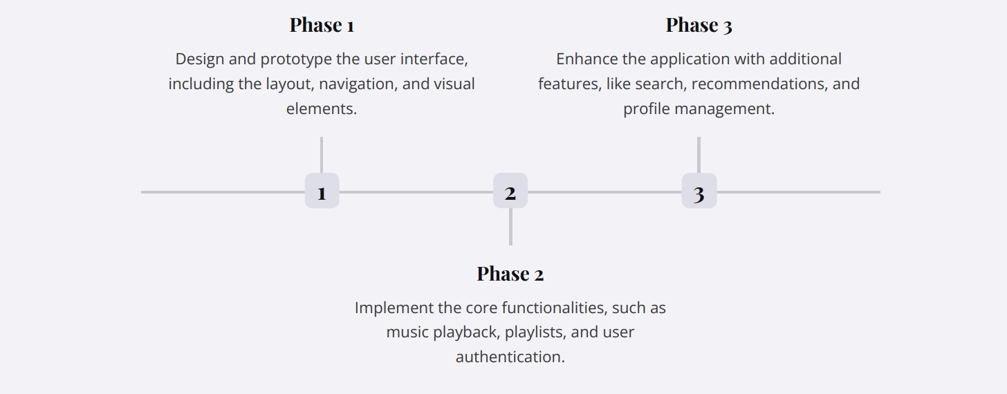
Development Phases

Slide 8
UI Design Highlights
Minimalist Aesthetic : The UI design follows a clean, minimalist approach, prioritizing simplicity and ease of use for the user.
Consistent Branding : The application's branding and visual identity are closely aligned with the Spotify brand, creating a familiar and cohesive user experience..
Dynamic Visualizations : Interactive visualizations, such as the music player and playlist displays, provide an engaging and visually appealing interface.

Slide 9
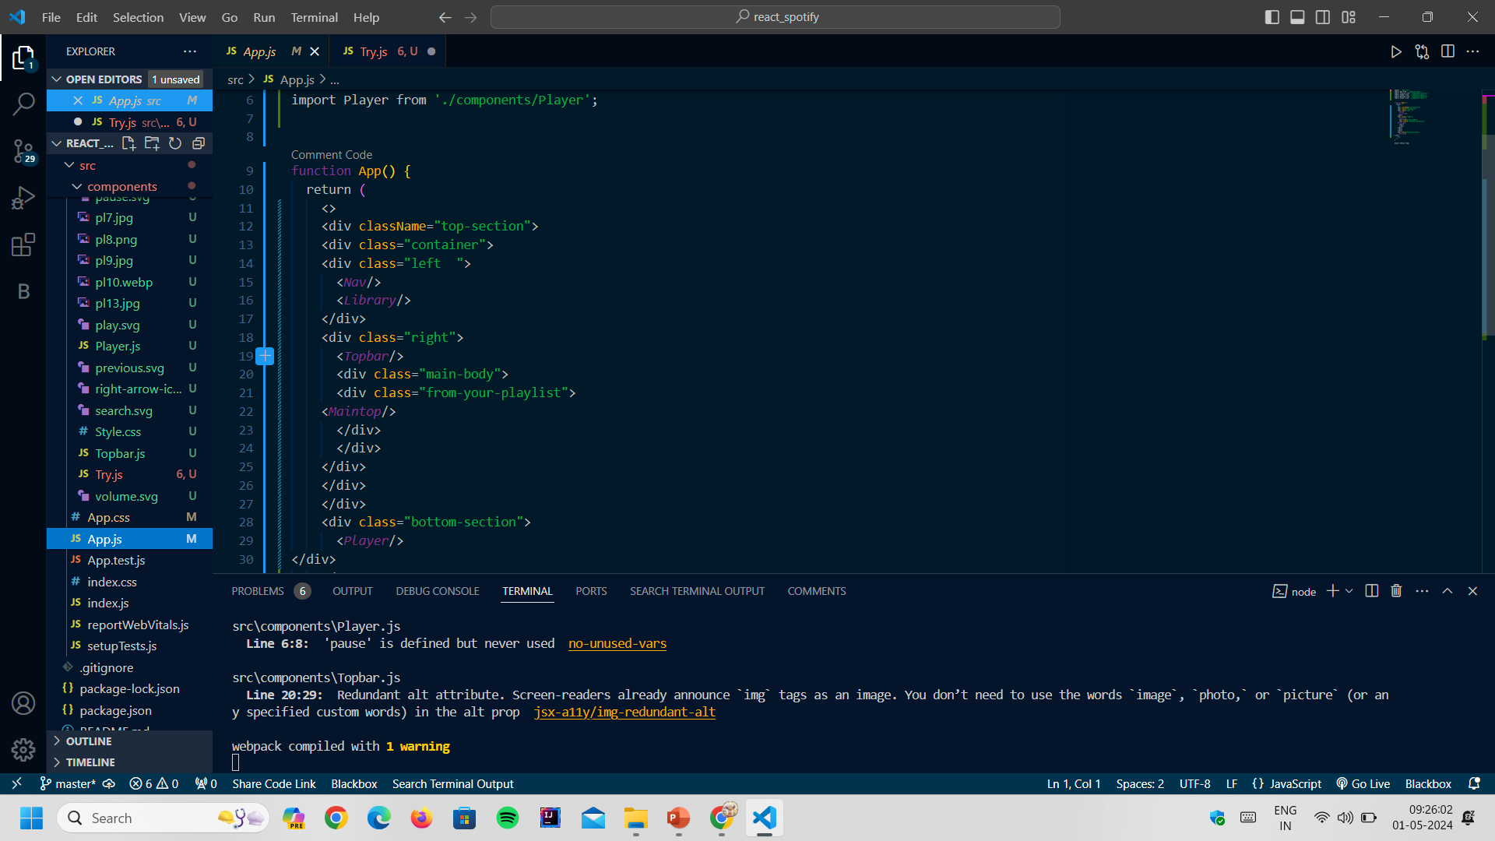
Project Highlights 1

Slide 10
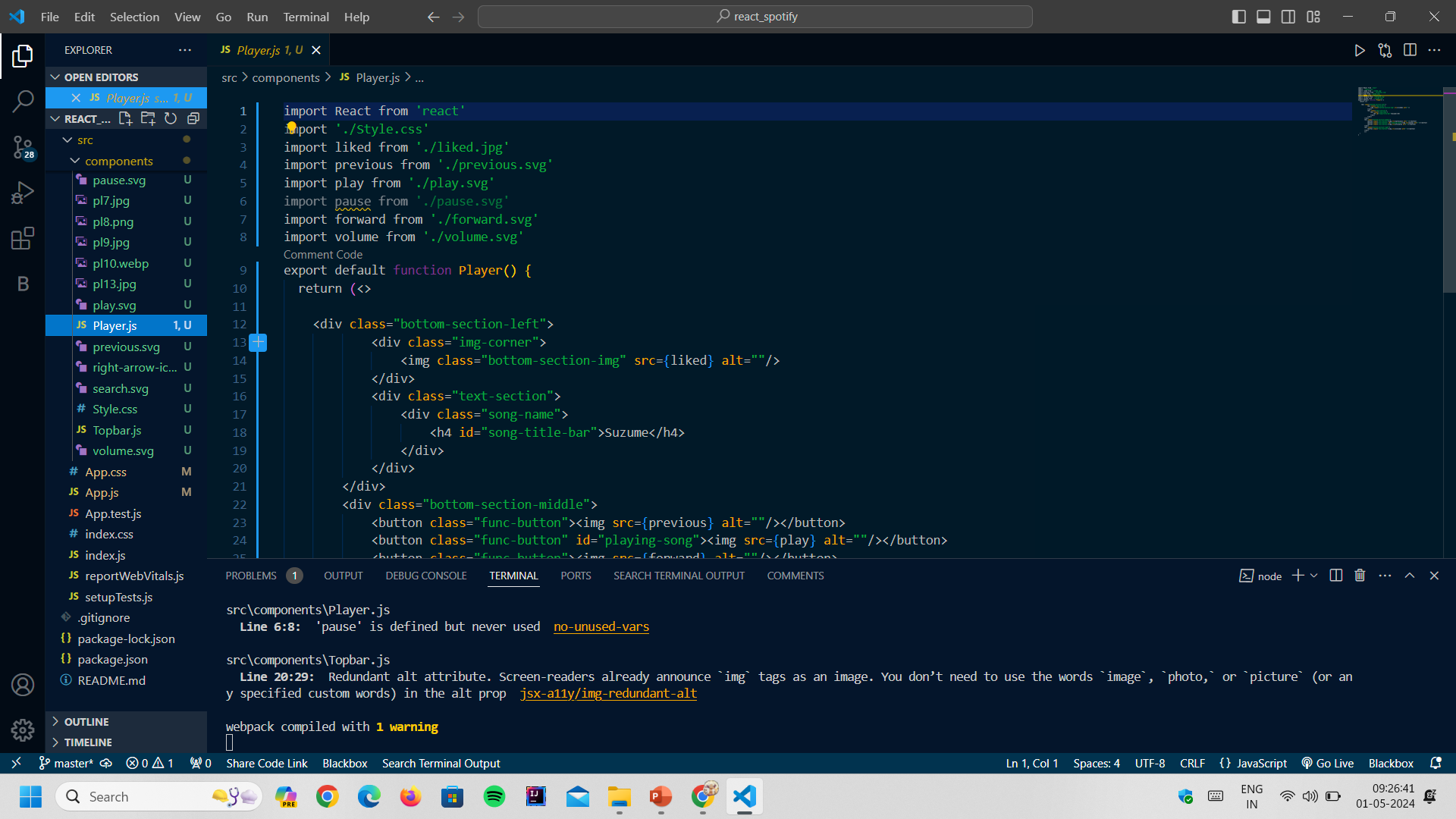
Project Highlights 1

Slide 11
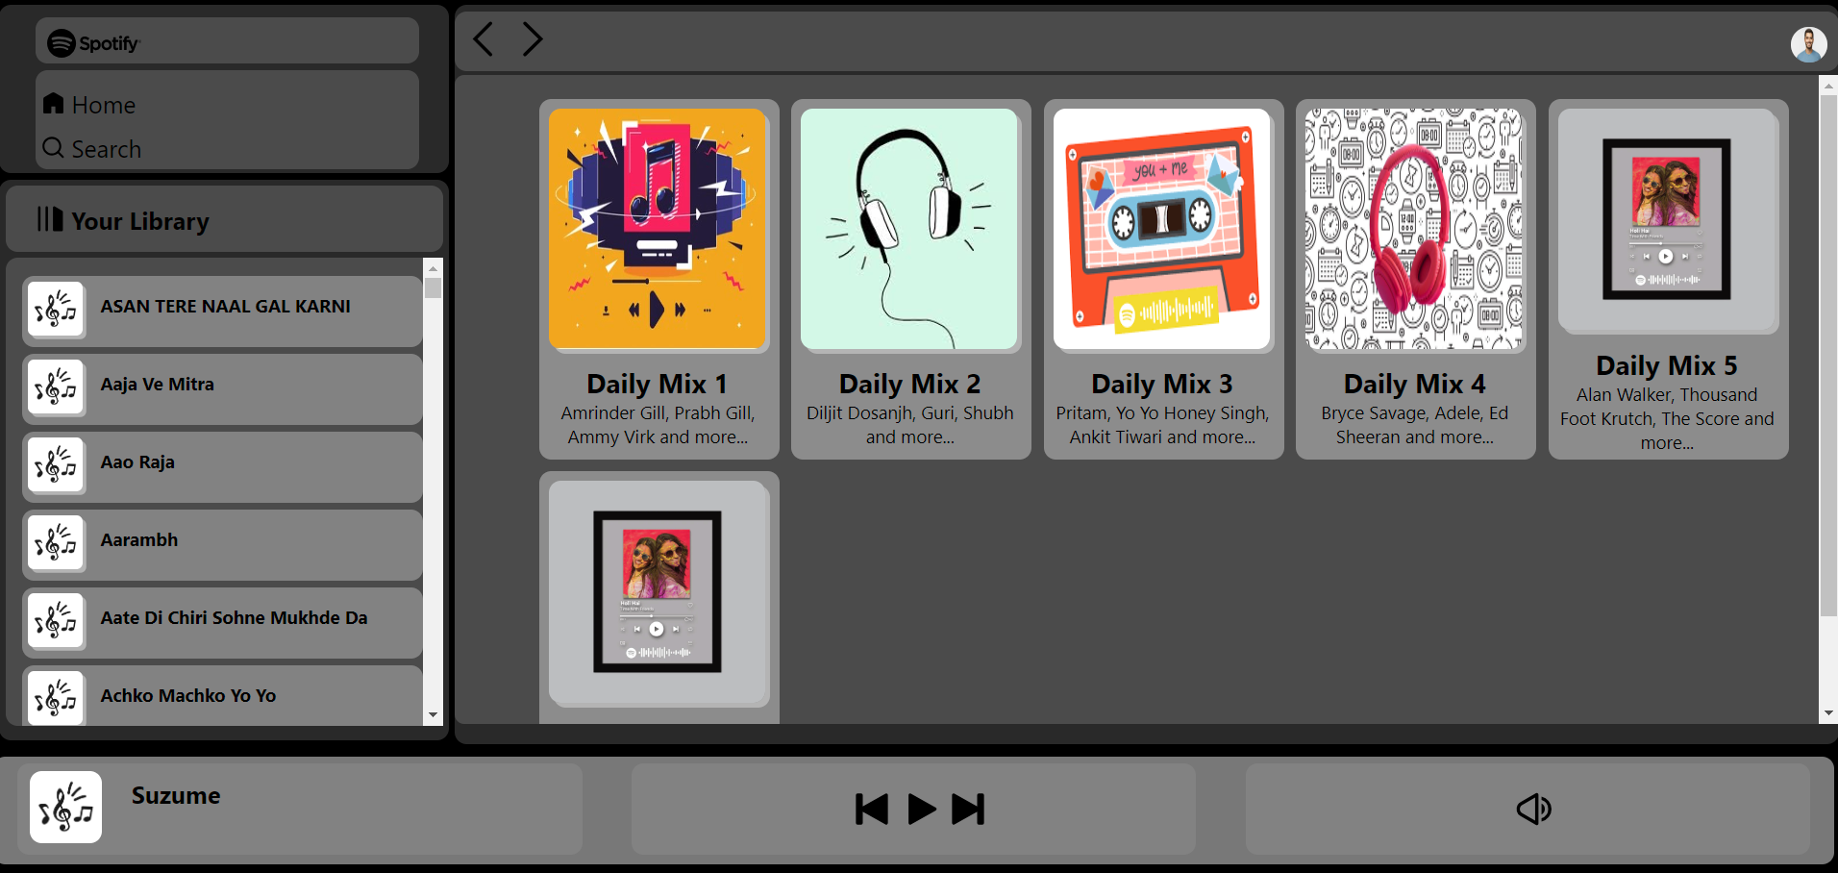
Project Highlights 2

Slide 12
Conclusion
.
The Spotify Clone front-end project has been a resounding success, delivering a high-quality, feature-rich music streaming application that closely emulates the Spotify experience. The project's innovative design, cutting-edge technology, and commitment to user feedback have positioned the Spotify Clone as a strong contender in the competitive music streaming market.

Slide 13
References/Links used
https://www.youtube.com/playlist?list=PLu0W_9lII9ahR1blWXxgSlL4y9iQBnLpR (JS)
https://www.youtube.com/playlist?list=PLu0W_9lII9agx66oZnT6IyhcMIbUMNMdt (React JS)

Slide 14
Thank You

